Slide 1
Calculator App Project
Created During Internship at Unified Mentor

Slide 2
Project Overview
The Calculator App was developed using HTML, CSS, and JavaScript.
It performs basic arithmetic operations with a clean and interactive UI.
Key features include:
Arithmetic operations (+, -, ×, ÷)
Memory functions (M+, M-, MR, MC)
Square root, percentage, and decimal support
Responsive and user-friendly design

Slide 3
Technologies Used
HTML: Structured the calculator layout and buttons
CSS: Styled the calculator using gradients, shadows, and hover effects
JavaScript: Implemented calculation logic and memory functionalities

Slide 4
HTML Structure
Input display field to show current calculation
4x5 grid of buttons including numbers, operators, and special functions
Buttons call respective JavaScript functions on click

Slide 5
CSS Styling
Linear gradient background for attractive UI
Rounded corners and box shadows for modern look
Button hover and click animations for interactivity
Responsive layout for all screen sizes

Slide 6
JavaScript Logic
Handles all button clicks and updates the display
`eval()` used for expression evaluation with error handling
Memory functions implemented using global variable
Special case handling for square roots and divide by zero

Slide 7
Error Handling
Division by zero and invalid inputs return 'Error'
Uses try-catch block around eval() to avoid breaking the app
Square root handled with Math.sqrt to avoid syntax errors

Slide 8
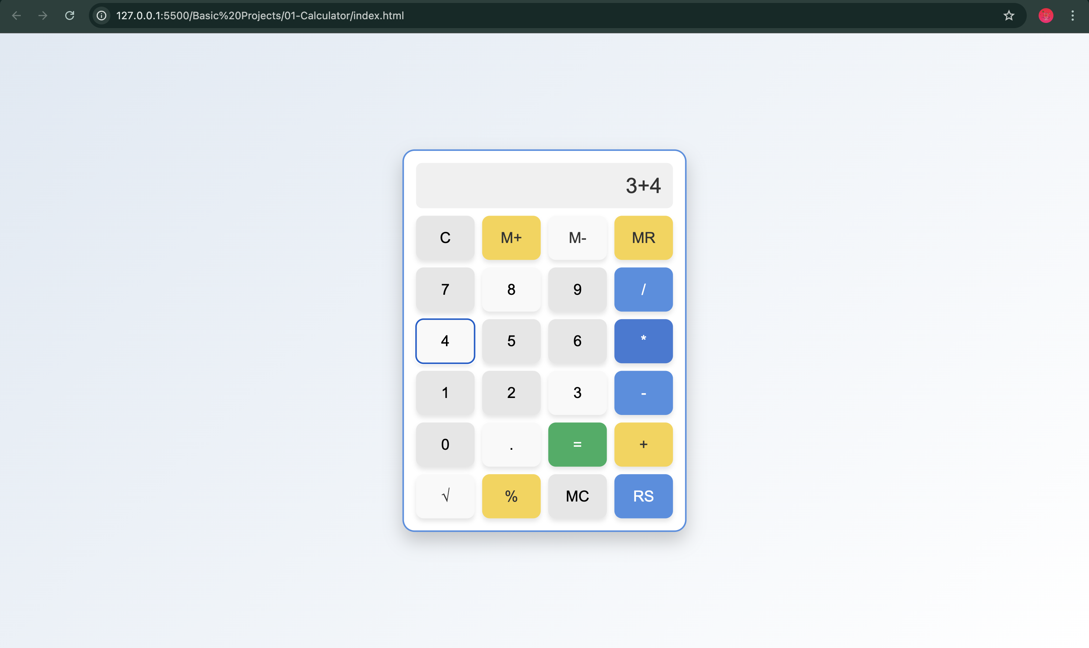
UI Preview

Slide 9
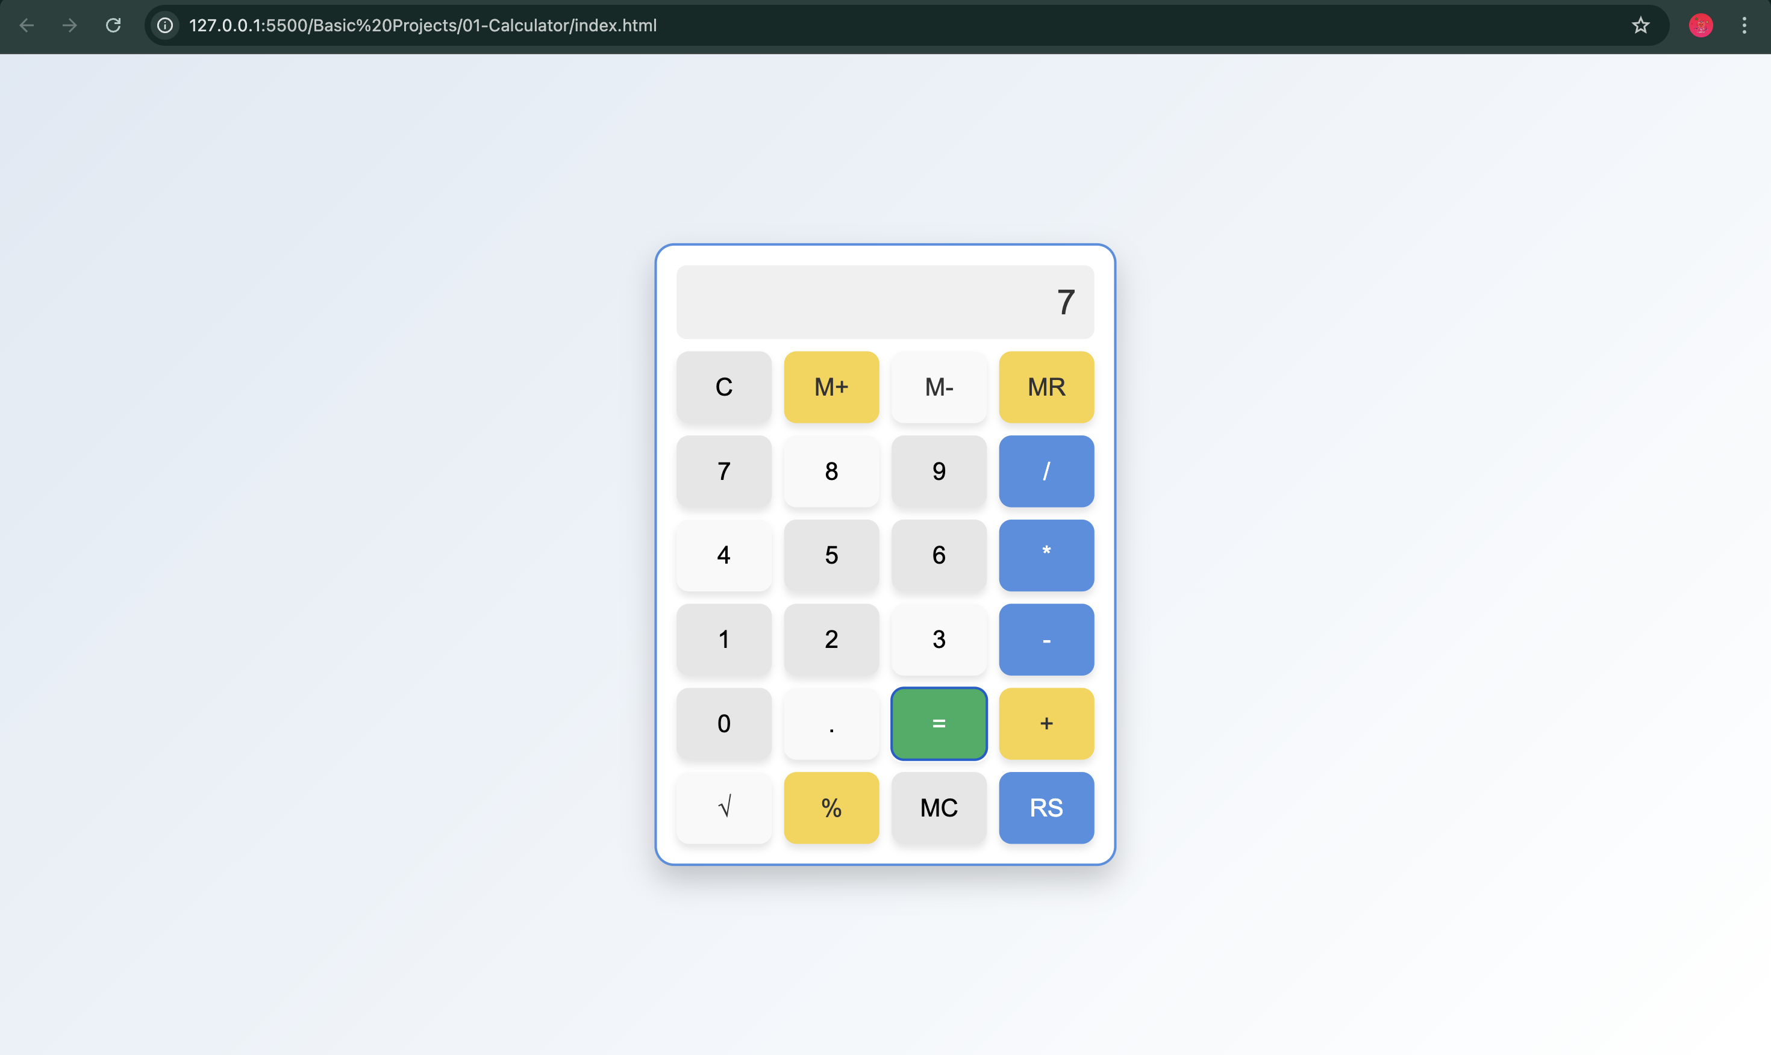
UI Preview

Slide 10
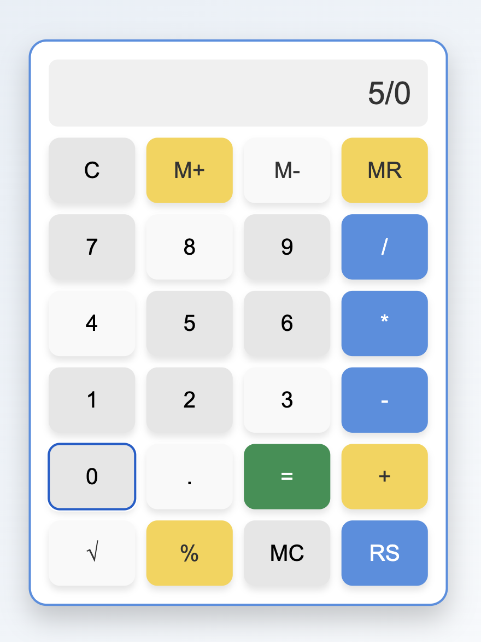
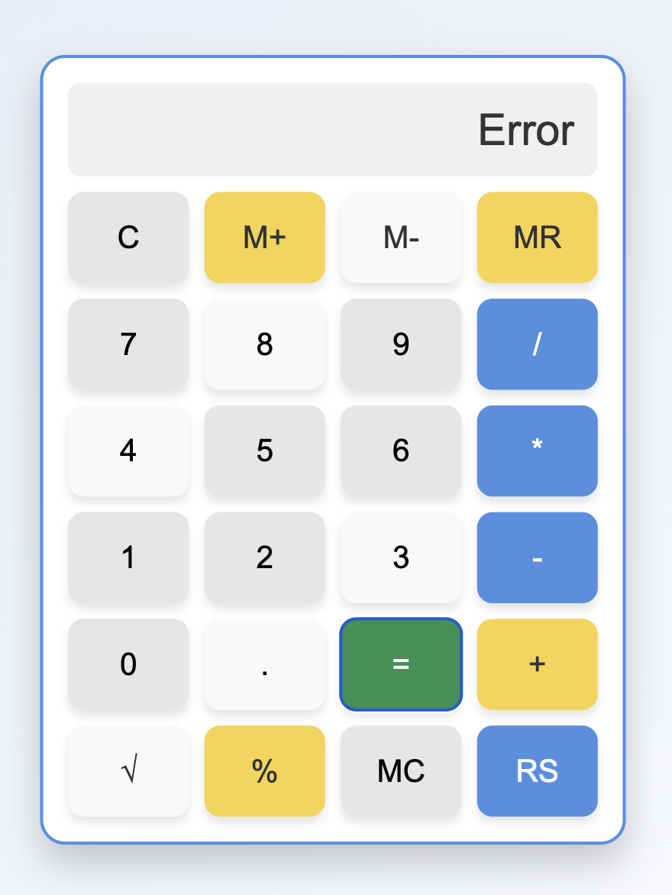
Error Handling Preview (Divide by Zero)

